Slide 1
24-Hour Hackathon Team - TechNova
Members name:
1.Bipin Basnet
2.Bibek Poudel
3.Pratik Panthi

Slide 2

Transport Management System
A Transport Management System (TMS) is a platform designed to digitally manage the movement of goods from one place to another. In the context of Nepal’s carrier system, a TMS organizes and automates processes that are traditionally done manually, such as recording goods, tracking quantities, calculating prices, and managing vehicle assignments.

Slide 3
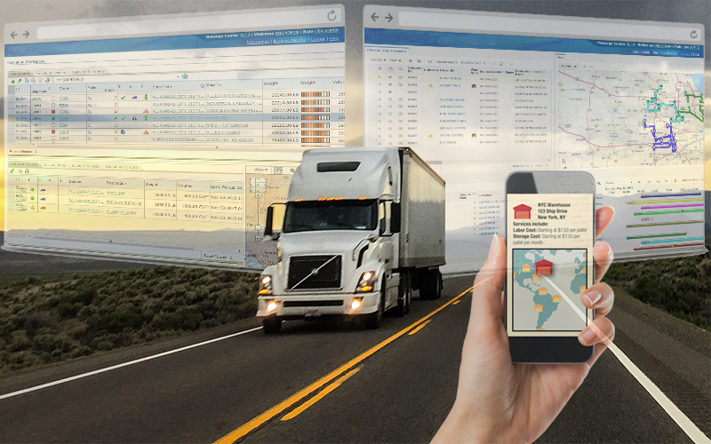
Advantages of transport management system
1.Saves Time
We can instantly check the stock , fast decision making and reduced manual work.
2.Increase efficiency
It reduce data entry time and we can access information quickly.
3. Technical benefit
We can access the website from anywhere at anytime.
4. Fewer Errors
Because most steps are automated, mistakes in paperwork, billing, and delivery planning are reduced.

Slide 4

Problems of Transport Management System
High Implementation Cost
Setting up TMS software, hardware, and training staff can be expensive for small transport companies.
Technical Complexity
Staff may struggle to adapt if they are used to traditional manual systems.
System Downtime
Internet issues, server crashes, or software bugs can halt operations.
Data Security Concerns
Risk of unauthorized access to sensitive customer and shipment information.
Maintenance Requirements
Continuous updates, backups, and technical support are necessary.

Slide 5
Solution of Transport Management System through our website
Digital Goods Management
Record goods, quantity, type, sender, and receiver in a systematic way.
Data Security Concerns
Use a TMS with strong security (encryption, password protection) and train staff to handle data safely.
Easy to access
All the data are stored in the website and we can easily access the data and report.
Goods tracking system
Whether the goods is delivered or not we can see from anywhere

Slide 6
Thank You

